Slide 1

Gis mini-course
Day 4: Scripting, Looping, and Automation

Slide 2
overview
For Loops and Nested Loops
If Statements
Mapping with Loops
Cluster Analysis
Using Loops to Optimize Clusters
Functions

Slide 3

For loops
Whenever you want to iterate functions across a data set or data sets, you can use a for loop
If you just want to print each row in a dataset you can write:
This code essentially cycles through one row at a time and prints the i^{th} row
Nrow(dataframe) returns the number of rows in the data frame which gives us 1 to the end of the frame
Dataframe[i, ] returns the i^{th} row and all columns associated with it

Slide 4
Nested loops
Nested loops allow multiple loops to occur within one subroutine
For example, you might want to loop through each state in the United States, then loop through each county and do some calculation or labeling procedure
Watch your indents and curly bracers {} carefully!

Slide 5
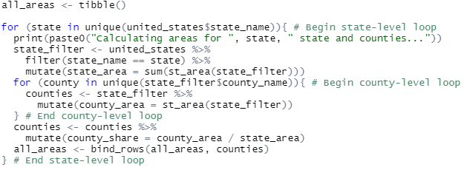
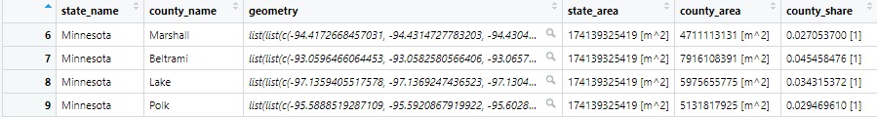

Slide 6
If statements
If statements can be useful to only conditionally calculate or manipulate a row
They can also be handy when a big loop is happening and you need to break, skip, or perform some function to make a shapefile valid before continuing

Slide 7
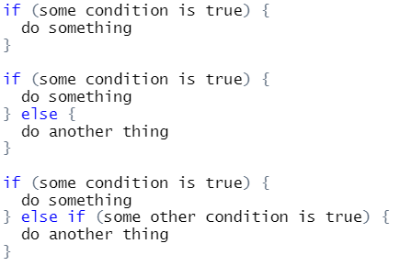

Slide 8
Looped mapping
You may want create a map or visualization on each loop, maybe print each state of the union each time you calculate something
You can do this with base R plot() or with ggplot combined with a print() statement
Ggplot might not be happy about our areas being stored as “units” rather than numeric.
You can circumvent this by wrapping the variable in as.numeric() as you’ll see in the code in the next slide

Slide 9
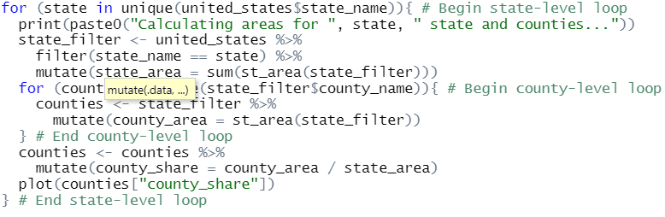
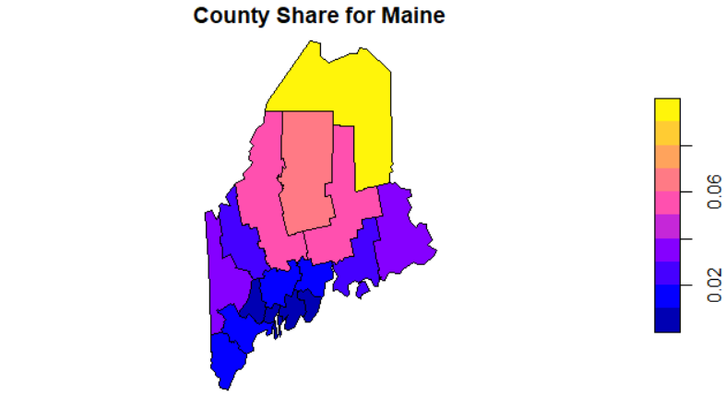
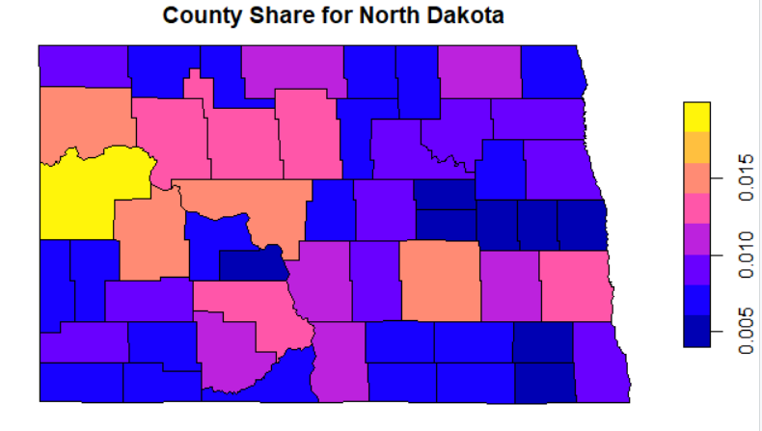
…

Slide 10
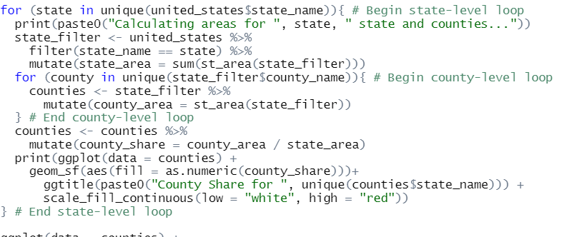
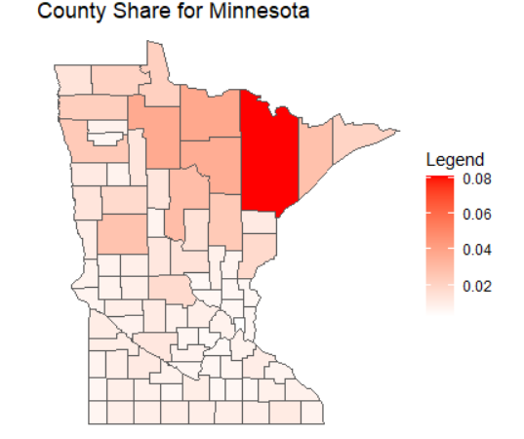
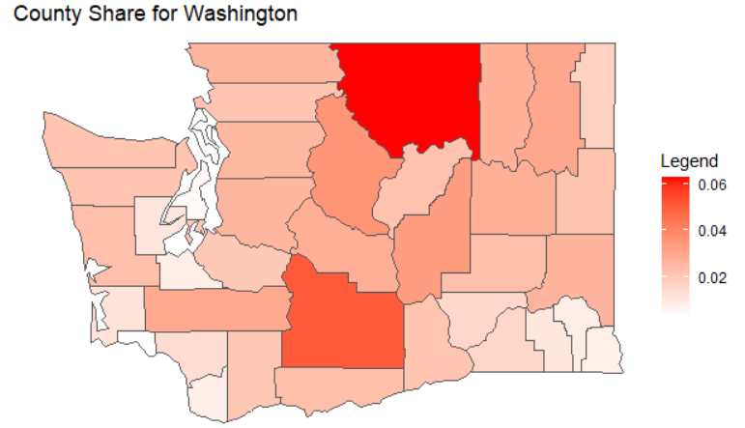
…

Slide 11
cluster analysis
We have waited this long to get to clustering because ultimately any run of a clustering algorithm will need to be compared and assessed before adoption
Loops and conditional statements can help tremendously in automating model comparison
If we want to find clusters with the Kmeans algorithm, like many algorithms, it requires us to specify an a priori number of clusters
But if we only pick k = 4, then what about k = anything else?

Slide 12

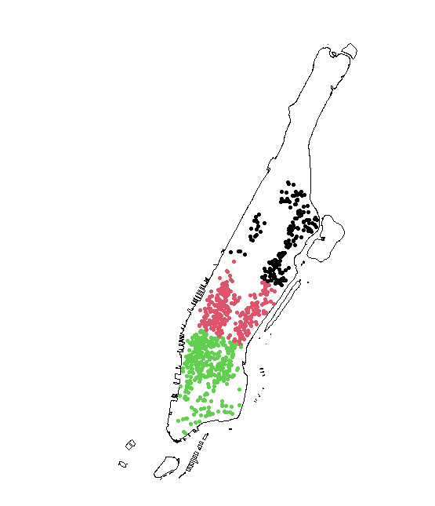

Slide 13
Cluster Model fitting
Loops can help to investigate just how many clusters is best, reasonable, explainable, etc.
Because clustering creates a within sum of squares measure which is like the variance of values within a cluster, this tells us how alike each data point is within a cluster
What we want is the lowest number of clusters as we want the simplest model but also want the lowest within-group variance so that the groups mean something!

Slide 14
What about k = 1,2,4,5…?
A for loop can help us find an ideal number of clusters to choose before running the algorithm by testing out each value of k (within reason)
We can then use the “elbow” method to choose the model where the parameter k reduces the total within sum of squares or within group variance as much as possible while retaining the simplest model
We can achieve this by slightly modifying the code and making the k parameter of kmeans() to reflect the iterator

Slide 15
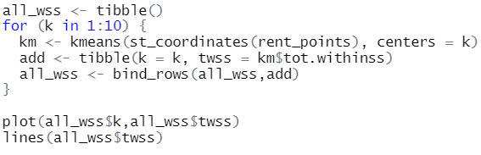
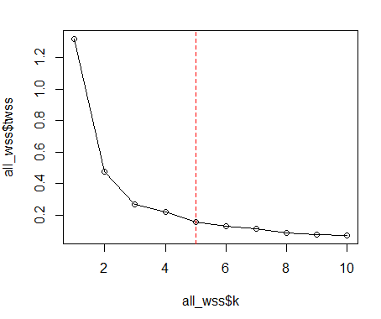
These lines collect the total within sum of squares and iteration info
Perhaps this is the elbow

Slide 16

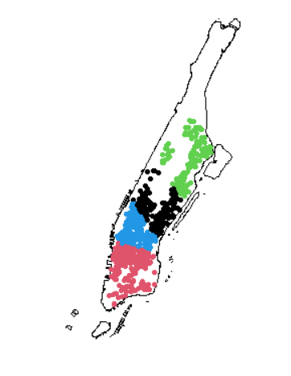

Slide 17
Spatial C(K)luster Analysis by Tree Edge Removal (SKATER)
The SKATER algorithm is an explicitly spatial clustering algorithm that creates and prunes a hierarchical tree
This tree is much like the spatial weight matrix be made in the last lesson
In short, the algorithm begins with one cluster, all data, then the algorithm finds the best place to cut the tree into two clusters, then out of the two, three, and so and so forth to n desired clusters
Multivariate!
Find a lengthy tutorial for SKATER in GeoDa here

Slide 18
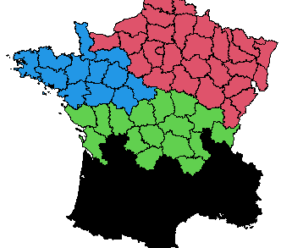
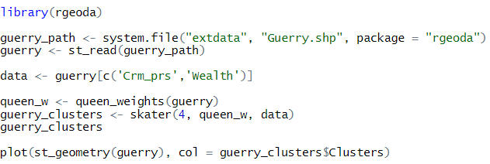
Using SKATER in rgeoda

Slide 19
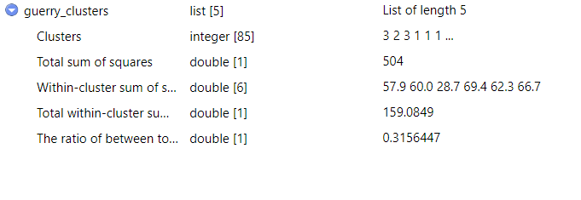
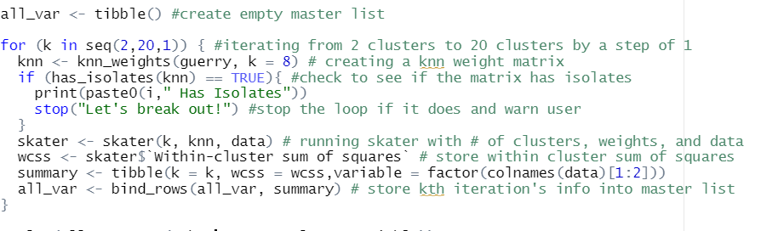
Summary of skater object content
Loop to measure variance of each

Slide 20
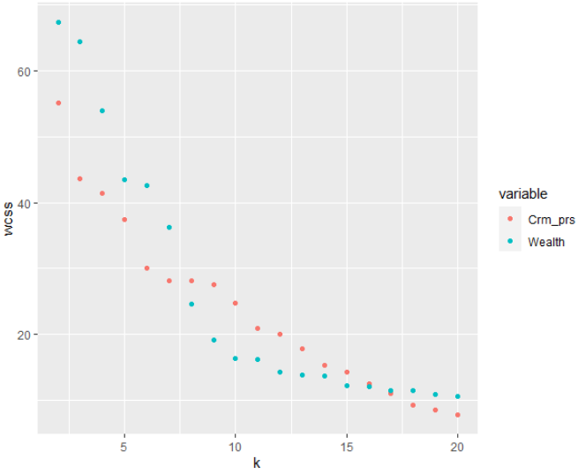
Looking at variance across iterations
You can then plot the within sum of squares for each variable to look for an elbow
When there are multiple variables present, it might become difficult to really choose an objective elbow point

Slide 21
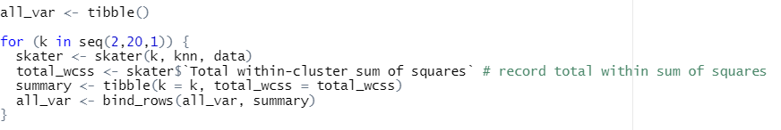
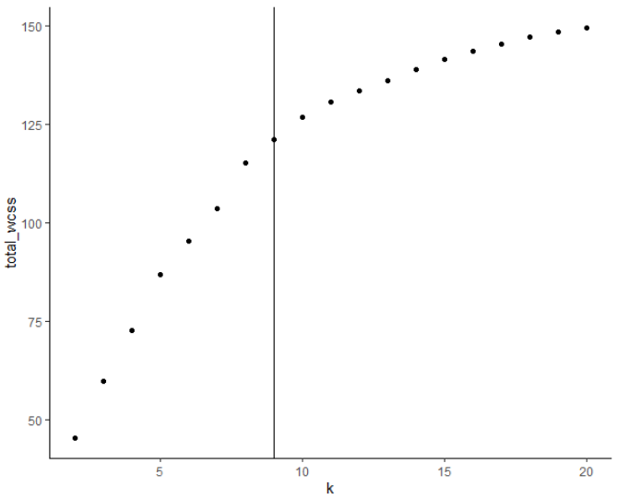
Using total within sum of squares

Slide 22
(Re)gionalization with (d)ynamically (c)onstrained (a)gglomerative clustering and (p)partitioning) (REDCAP)
Like SKATER, REDCAP starts from building a spanning tree with 3 different ways (single-linkage, average-linkage, and the complete-linkage).
“Bottom-up” – builds clusters by agglomerating rather than cutting down a master cluster
Then, REDCAP provides 2 different ways (first‐order and full-order constraining) to prune the tree to find clusters.
See: D. Guo (2008) Regionalization with dynamically constrained agglomerative clustering and partitioning (REDCAP), International Journal of Geographical Information Science, 22:7, 801-823, DOI: 10.1080/13658810701674970

Slide 23

Functions
Functions allow you to—you guessed it—make your own functions
This isn’t necessary but could potentially save a lot of typing for you
For example: If you find yourself typing out CRS equivalencies a lot you can make an easy function for yourself

